Slide 1
IB Psych 10/21/16
Turn in:
Nothing
Take out :
Planner
Your phone…
Writing Implement
Notes
Your Notes from your Reading…
Today’s Learning Objectives:
BLOA: 1-13
Today’s Agenda:
Positive Emotions
HW:
Caspi et al (2003) CRA/Chart it & short answer Learning Outcomes: HARD COPY DUE MONDAY

Slide 2
Let’s look at the week…
1st—We had an open-note quiz…
Which hopefully encouraged you to examine your decision-making—then we also looked at the science of risk in adolescence…
Yesterday, we perhaps experienced some stress—and hopefully some thoughts about how to USE stress…

Slide 3
Let’s look at the week…
Maybe this has been a rough journey for some of us (myself included…☺) & maybe it hasn’t…
Either way, today I believe we deserve some positive emotions (and other physiological experiences)!

Slide 4
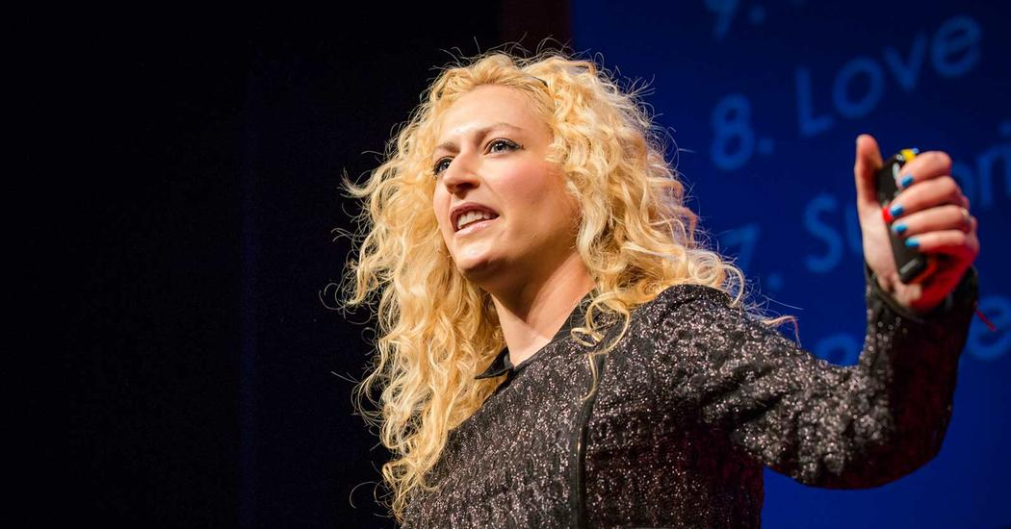
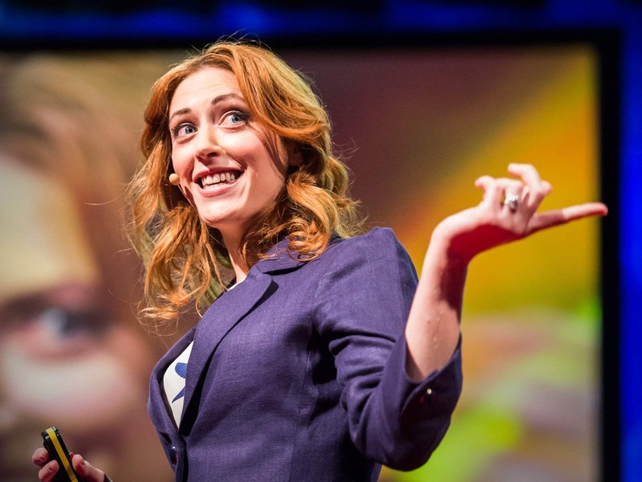
I’m hoping you remember Dr. Kelly McGonigal…
Well, she has a twin sister! And yes, of course, she also has a TED talk we’re going to watch…

Slide 5
Dr. Jane McGonigal & Some Positive Emotions
Joy
Relief
Love
Surprise
Pride
Curiosity
Excitement
Awe & Wonder
Contentment
Creativity

Slide 6
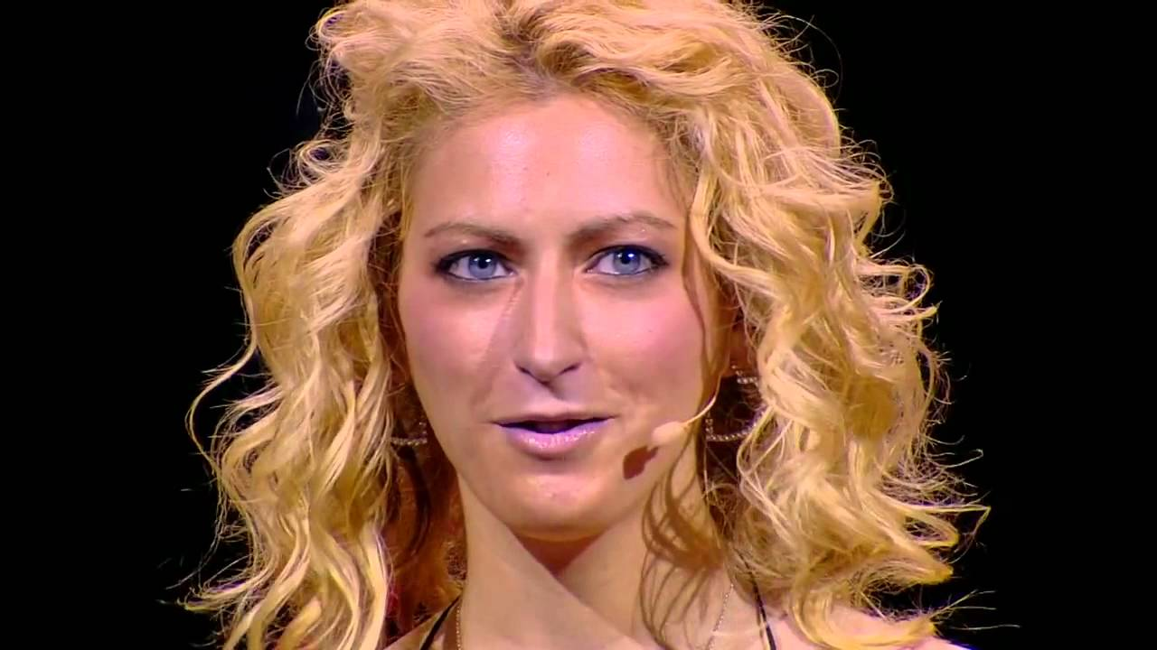
Dr. Jane McGonigal https://www.ted.com/talks/jane_mcgonigal_massively_multi_player_thumb_wrestling?language=en#t-34824
She’s a gamer, game-developer, future-forecaster, and professor at UC Berkley. So, what’s the TED talk about??? Let’s find out—IT’S INTERACTIVE, SO BE PREPARED!

Slide 7
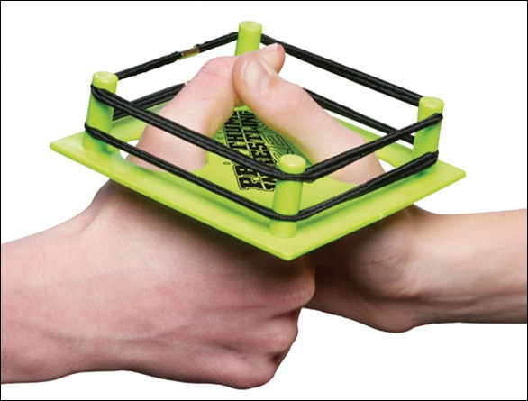
Massive Multi-Player Thumb Wrestling
Rules: 1. Thumb-Wrestling basics Basically, thumb-wrestling works like this: 2 players put the fingers of their right hands together, then form a fist keeping the thumbs up. The player who first manages to tie down the other's thumb and hold it tight wins. In case a referee is present he or she will mark the winner's thumb with chalk. The winners raise their hand. 2. Multiplayer Thumb-Wrestling It is possible to put together three hands of three players who want to indulge in thumb-wrestling. A nodal network is formed. In a game of three, the player holding tight the thumb which is furthest down is the winner. All other thumbs (further up) have a walk-over for the two thumbs furthest down are frozen already. Since humans have two hands the left hand can be used to connect even more players to the network. Thus, various possibilities pop up. 3. Warm-up Warm up before the wrestling. Only practice safe wrestling! 4. Fair Play No violence, please! We compete but we do not fight. Understood? The hands are to be kept as still as possible. Clipped nails are extremely helpful. No lubricants. 5. Report If you host a Multiplayer Thumb-Wrestling event please announce it at monochrom (email tothumb(at)monochrom(dot)at) or post it on Twitter(#mMMTw). We would really like to know what's happening. We don't want to keep you in check or anything, but we are really interested in documenting where the idea will end up.

