Slide 1
IB Psych 11.16.16
Turn in:
No thing
Take out :
Planner
Writing Implement
Notes
Today’s Learning Objectives:
I can discuss with reference to relevant research studies, the extent to which one cognitive process is reliable.
Today’s Agenda:
Memory
Loftus video
Another Activity
HW:
CRA 3.5

Slide 2
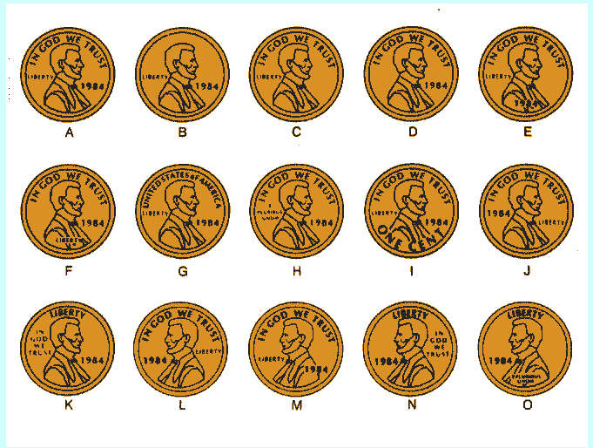
Write down which letter corresponds to the correct representation of a current US Penny ($0.01)

Slide 3
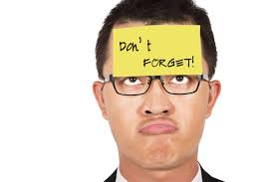
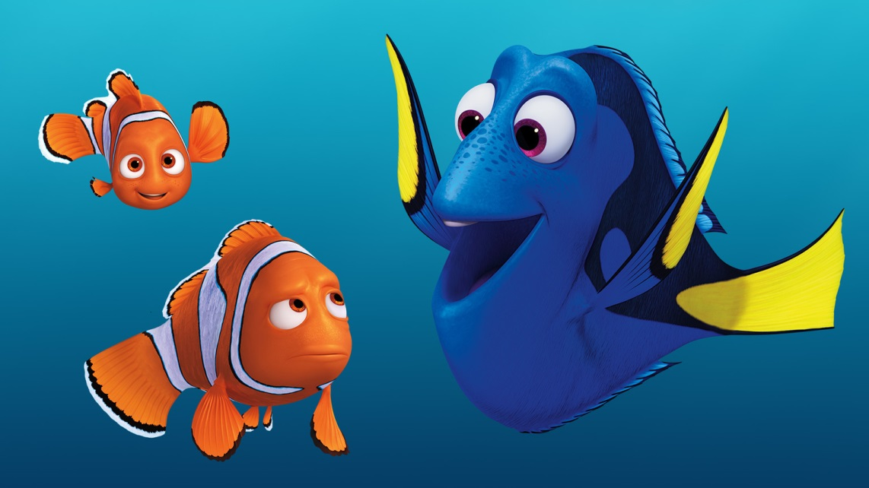
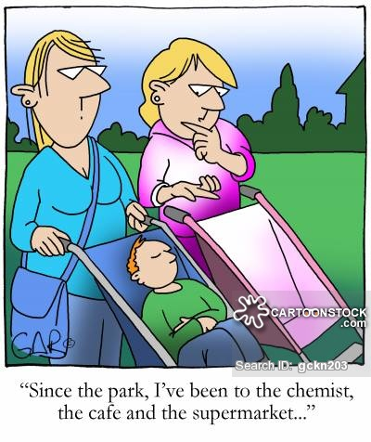
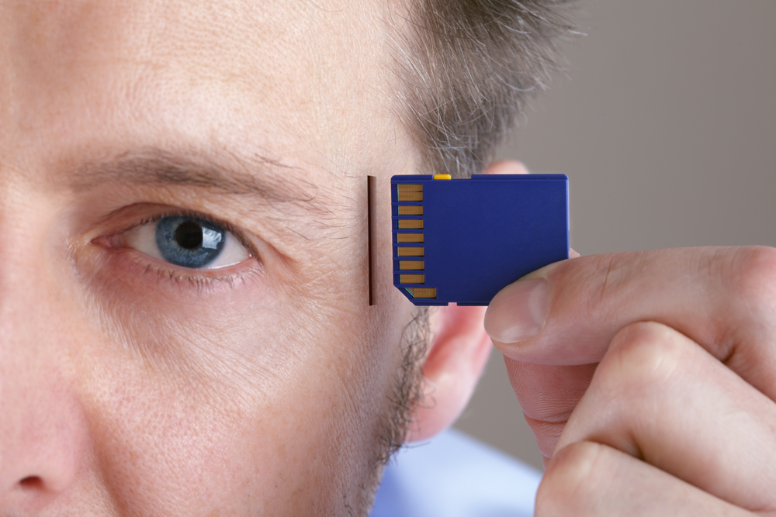
What is your earliest memory??? Write it down…

Slide 4
How old were you???

Slide 5
Are you comfortable sharing? What were you doing?

Slide 6
So, what is memory? How do we form them? How do we “hold” onto them?

Slide 7
Loftus Video
https://www.youtube.com/watch?v=PB2OegI6wvI

