Slide 1
10th World Studies 12.15.16
Turn in:
Philosophes Theses…to the box!
Take out:
  Planner
  Pen/Pencil
  Notes
  Stamp
Today’s objective:
  I can describe the mood of France leading up to the events of the French Revolution
Today’s Agenda:
The Ancien Regime & The Three Estates in “Action”
HW:
CRA “What is the Third Estate?”
  Find your BEST 5 pieces of evidence—we’ll see if we can match them up with Enlightenment Philosophes tomorrow…

Slide 2
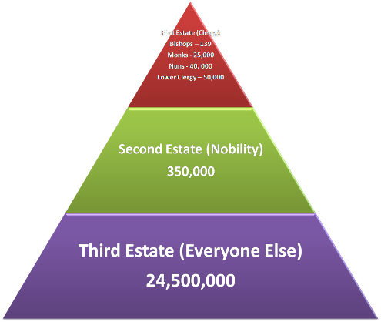
The ancien rÉgime
Look familiar?!?
Let’s try to put it into practice…
The 1st ESTATE: The Church & it’s Clergy
The 2nd ESTATE: The Nobility
The BOURGEOISIE : Not nobility, not a peasant…more in line with the “middle class” Merchants, small business owners…
The 3rd ESTATE: Everyone else: although there were differing levels here as well…

Slide 3
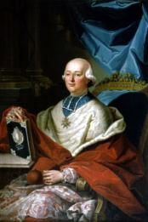
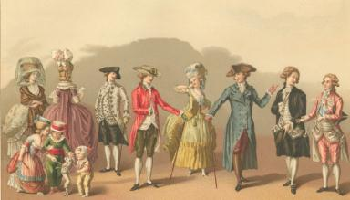
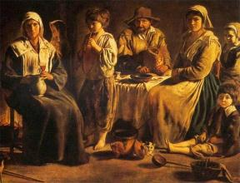
France’s population was approximately 27 million in 1788. We need to determine to which estate you will belong…
How do you determine which Estate you will be born into?
…By the “Sticks of Fate” of course!
Please gather by your Estate & read your information to familiarize yourself with your new estate.

Slide 4
Starting Money: We will have “rounds” The King requires you to briefly record your thoughts/issues (cahiers) in your notes after each round
1st Estate About 1% (1 of you…):
Clergy - $500 (5 -$100)
2nd Estate About 2% (2 of you…):
Nobility - $300 (3 - $100)
The 3rd Estate—The other 97% (the rest of you…)
About 10% (6) of the 3rd Estate Bourgeoisie – $100 (6 $10, 8 $5)
About 90% (of the 3rd Estate—Peasant
$50 (4 $10, 2 $5)…or until the small money runs out?!?

Slide 5
Because I, the King, do not want to anger my higher status citizens I do what I can to keep them pleased.
If you are part of the 1st estate – you may take $50 from the King.
If you are part of the 2nd estate – you may take $20 (1 $10, 2 $5) from the King.
If you are part of the 3rd estate – Sorry, you are not part of the privileged class and will not receive any money ☹ ☹
Please make a note about how you’re “feeling” in your role…

Slide 6
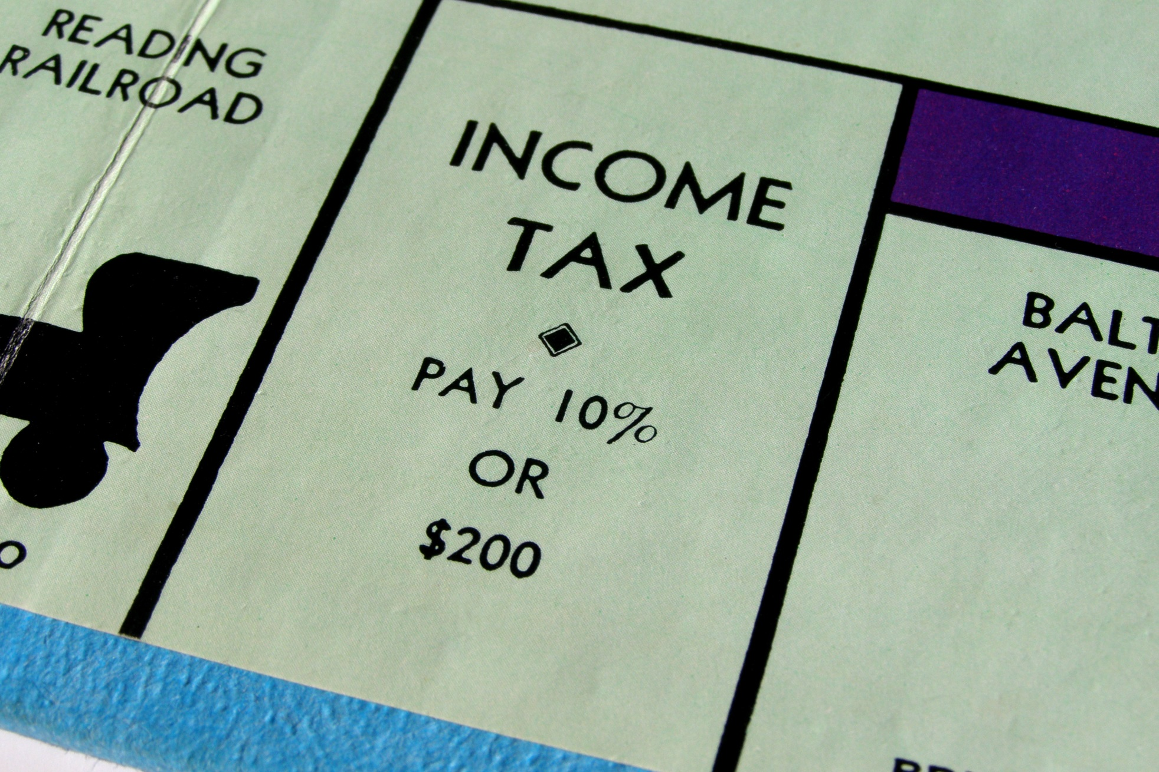

Time to pay your Taxes…

Slide 7

1st Estate – You pay no taxes!!
2nd Estate – You pay no taxes!!
3rd Estate –
  Pay $5 to the 2nd estate
  Pay $10 to the 1st estate

Slide 8
Church Tithes are due
The church of Sainte- Genevieve needs new stained glass windows…
1st Estate – you pay no church tithes!!
2nd Estate – Pay $5 to the 1st estate
3rd Estate – pay $20 to the 1st estate

Slide 9
Monthly Pay
Members of the 1st estate: $200
Members of the 2nd estate: $100
Members of the 3rd estate:
  Bourgeoisie: $50
  Peasants: $20
Write down how much $ you have…how are “things”???

Slide 10
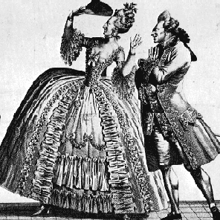
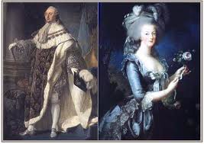
Life in the lap of luxury
While the 3rd estate is working, providing for their family and paying taxes and tithes the king and queen are seen buying wealthy clothing, gems, gifts and having lavish parties
  If you are part of the 1st or 2nd estate come grab a piece of candy from the party

Slide 11
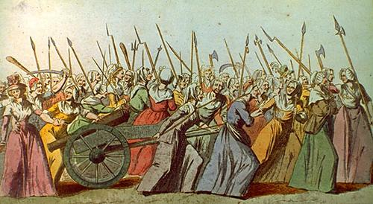
Continue living your life…
3rd Estate (Peasants ONLY):
  You must work in the mills or on the farms
    a.k.a. wipe down all desks/chairs at your table group! Yes… I’m being serious!
      You earn $20 (take from the King)
      BUT… you must pay the nobles for allowing you to work on their land, therefore, PAY $10 (to the 2nd estate)
  You also must feed your family
    Bread will cost you $5 (give to the King)

Slide 12
Monthly Pay
Members of the 1st estate: $200
Members of the 2nd estate: $100
Members of the 3rd estate:
  Bourgeoisie: $20
  Peasants: $10

Slide 13
Palace of Versailles
King Louis XVI is not in a good mood ☹ He needs to plant 13,000 new trees in his beautiful garden and add 3 new fountains.
  3rd estate should pay $10 each for this upgrade. (to the King…)

Slide 14

France needs to pay back war debts…
Because the King and Queen want to keep the privileged classes loyal, they demand more taxes for the 3rd estate.
1st Estate
  Pay nothing
2nd Estate
  Pay nothing
3rd Estate
  Pay $20 to the Queen

Slide 15
Monthly Pay
Members of the 1st estate: $500
Members of the 2nd estate: $300
Members of the 3rd estate:
  Bourgeoisie: $100
  Peasants: Due to bad crops, you were only able to earn $30 (2 $10, 2 $5) this month.

Slide 16
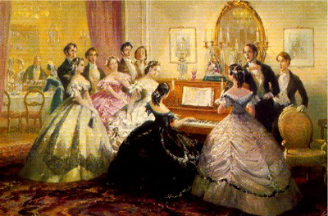
Friends at court…
King Louis XVI and Marie Antoinette want to keep their privileged class happy and loyal to them. Especially during the time of bankruptcy and the time of enlightenment
Because of this, the first and second estate are invited to a party at court
  Please come grab a piece of candy (1st and 2nd estate only)
1st estate
  Take $50 from the King
2nd estate
  Take $20 from the King

Slide 17
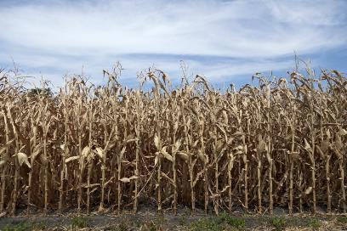
A Drought has hit France…
Because France’s economy is based on agriculture, the peasant farmers struggle to harvest enough crops to feed their family and pay the nobles, clergy and government.
Due to the small amount of crops…
The 3rd Estate (Peasants ONLY)
  earns $15 (from the Queen)
3rd Estate (Peasants ONLY)
  Pay $5 to the nobles (2nd estate)
  pay $5 for bread (to the Queen)

Slide 18
Monthly Pay
Members of the 1st estate: $500
Members of the 2nd estate: $300
Members of the 3rd estate:
  Bourgeoisie: $50
  Peasants: Due to drought, you make $5 this month…

Slide 19
Bills, Bills, Bills…
Members of the 1st estate: No Bills ☺
Members of the 2nd estate: No Bills ☺
Members of the 3rd estate:
  Bourgeoisie: $5
  Peasants: Please pay $30

Slide 20
Estates Debrief
Please answer the following on a blank note card
How much money do you have?
  More or less from when we started?
Who had the most? The least?
What are the problems with this system?
How did you feel during the simulation?
You need to put all the money back in the same way you received it!
Make sure there is a rubber band keeping it all together
Have one person bring the money to King Steen

Slide 21
Closing Activity
Please write a formal letter to King Louis XVI
  This letter should include your reaction to this activity
    3RD Estate:
      What should he do as King to fix the problems in society? How can he help you?
    1ST & 2ND Estate:
      Warn him of the actions you see the 3rd estate taking – is there rebellion in the near future?
Please write on separate piece of paper
  Minimum of half a page
  Due before you leave class today

