Slide 1
10th World Studies 12.15.16
Turn in:
Philosophes Theses…to the box!
Take out:
Planner
Pen/Pencil
Notes
Stamp
Today’s objective:
I can describe the mood of France leading up to the events of the French Revolution
Today’s Agenda:
The Ancien Regime & The Three Estates
HW:
CRA “What is the Third Estate?”
Find your BEST 5 pieces of evidence—we’ll see if we can match them up with Enlightenment Philosophes tomorrow…

Slide 2
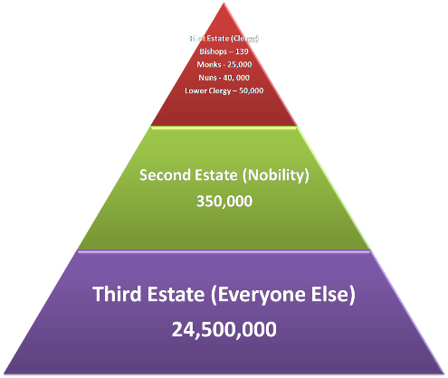
The ancien rÉgime Look familiar?!?
Let’s try to put it into practice…
The 1st ESTATE: The Church & it’s Clergy
The 2nd ESTATE: The Nobility
The BOURGEOISIE : Not nobility, not a peasant…more in line with the “middle class” Merchants, small business owners…
The 3rd ESTATE: Everyone else: although there were differing levels here as well…

Slide 4
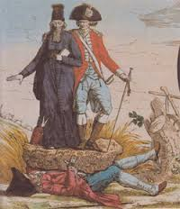
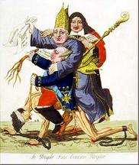

Slide 5
THE THREE ESTATES
1st Estate
2nd Estate
THE LAW
3rd Estate

Slide 8
Economic Issues
Wars and extravagant spending had caused serious economic hardship
7 years war
American Revolution
Taxes were high on the 3rd estate
½ government income goes toward paying interest on debt
Jacques Necker (Finance Minister) proposes taxing first two estates. Fired by Louis XVI under pressure from nobles

Slide 11
A visual representation of the representation of the population of France.

Slide 12
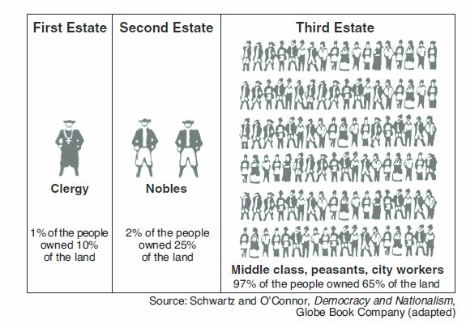
A visual representation of the representation of the population of France.

