Slide 1
IB Psychology 2.2.17
Turn in:
Hard Copy of SAQ
Please bring them to the front…
Take out:
Notes, notes, notes
Today’s Learning Objectives:
Explain Social Learning Theory
Today’s Agenda:
Socio-Cultural Level of Analysis
SAQ Practice
HW:
Original & Revised Hard Copy of SAQ

Slide 2
When you receive peer’s work:
Please read it through once.
Please begin reading again…this time with the descriptors in mind…
Using a BLACK pen, provide useful feedback and award marks as you see fit—in relation to the work…please put your name in the top left corner.
Please return it to the author, without discussion…

Slide 3
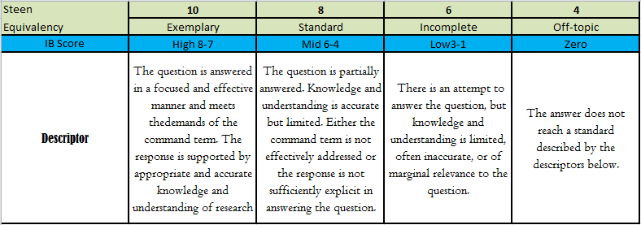
Mark Bands
But how to apply these descriptors?
Do your best…please provide brief commentary where appropriate…

Slide 4
2nd time through…
You pick your editor…
Please read it through once.
Please begin reading again…this time with the descriptors in mind…
Using ANYTHING OTHER THAN black pen, provide useful feedback and award marks as you see fit—in relation to the work…please put your name in the top right corner.
Please return it to the author, without discussion…

Slide 5
Mark Bands
But how to apply these descriptors?
Imagine you are not fully aware of the information. Does the author provide clarity?

Slide 6
Please revise…
Now, you can discuss with your editors…
Please TYPE your final draft—to be turned in tomorrow…as a hard copy. (Along with your first draft…)

