Slide 1
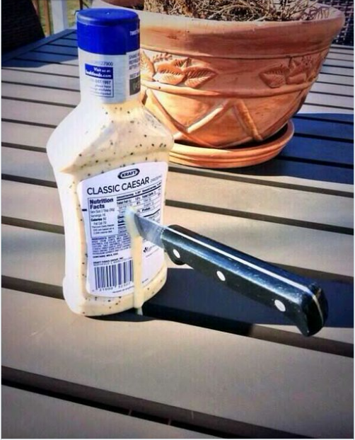
10th World Studies 3.15.17
Turn in:
Nothing yet…
Take out:
NOTES—they’ll be brief, but important!
Your edited drafts of outline
An internet device
Today’s objective:
I can give and receive meaningful feedback to my Sophomore Research Paper, in order to create a complete FINAL DRAFT!
I can follow directions in turning in my SRP Process Packet…
Today’s Agenda:
Points of Interest
HW:
TII.com submission—11:59pm!
Process packet DUE AS YOU ENTER CLASS THURSDAY!!!

Slide 2
Steen’s “Issues” with Papers
Contractions:
DON’T do it…again, please DON’T DO IT!!!
Abbreviations:
Legit avoid this…TYT, and write it out! You’re not texting or tweeting, etc.

Slide 3
Steen’s “Issues” with Papers
Punctuation:
If you are wondering, please use tools in your word processing program and/or ask someone else…
Semicolons seem to be having a resurgence of popularity; however, very few writers know how to use semicolons correctly.
Conclusion:
“All in all,” “To sum it up,” “In conclusion,” etc. insult me…If you’re needing to do this, perhaps IDK what the purpose of your writing/message might be…

Slide 4
Steen’s “Issues” with Papers
Word Count
1200-1500—what if I’m at 1199??? What if I’m at 1501??? What if I just can’t cut any words & I’m at 1700???
1200-1500 means just that...
Sources
Do I really need 6??? Do I really need 2 print sources??? Do I really need 2 Primary???
What does minimum mean???

Slide 5
EVEN MORE POINTS OF INTEREST
Directions!!!
12 Point, Times New Roman font!!!
Double-spaced, 1” Margin
“When all else fails…”
ALL citations (Yes, including in-text) follow MLA 8th Edition formatting!
Help is available on the note card directions! Help is available on Ms. Bacon’s website as well!
Here’s the link I recommend (provides examples for nearly every scenario): https://owl.english.purdue.edu/owl/

Slide 6
Points of Interest!
Be sure to look at your similarity report from TII.com!
Steen worries about two types of numbers:
really low (might mean little to no evidence)
really high (might mean “too much of other’s work”)
It’s a draft, so be prepared to actually revise…utilize people that don’t “love” you…NHS, tutoring, conferences w/us or others that are willing…

Slide 7
Points of Interest!
I will be marking your papers as if it were a final draft, so you will know exactly where you stand…
If you didn’t turn it in with both versions, you’re at the back of the line…I will return them as I finish them…you can set up times to meet with me once you get it back—be ready with specifics.
“I just need help!” is not specific enough for ol’ Steen

Slide 8
Points of Interest!
Look back at your TRS
Track the progression…is your thesis following your evidence?
Do you still need to shape your thesis? THAT’S OK!!!
Look at your Outline(s)
What suggestions have you received?
What changes have you made?
Continue to look at your rough draft
Do you have all the parts of the intro/conclusion?
Have you cited all of your evidence?
Is all that’s in your paper in your WC (and vice versa)?

Slide 9
Works Cited
No separate heading is needed
Begin your Works Cited page on a separate page at the end of your research paper. It should have the same one-inch margins and last name, page number header as the rest of your paper.
Label the page Works Cited (do not italicize the words Works Cited or put them in quotation marks) and center the words Works Cited at the top of the page.
List in ALPHABETICAL ORDER: by author,
Double space all citations, but do not skip spaces between entries.
Indent the second and subsequent lines of citations by 0.5 inches to create a hanging indent.

