Slide 1
IB Psych 9/6/16
Turn in:
Syllabus Agreement
Take out :
Planner
Notes/Paper
Note-taking devices
Today’s Learning Objectives:
I can make a determination as to the degree of “science” in Psychology.
Today’s Agenda:
Touching base from Friday
Website, class accounts, etc
Intro to course
HW:
Website stuff
Syllabus
Learning Outcomes

Slide 2
What is Psychology???
What YOU wrote…
A “Textbook” Definition
--how the brain works…
--human behavior…
--the study of emotions…
--study of the mind…
--why we do what we do…
--how individuals or groups think…
--habits & social characteristics…
“The scientific study of the behavior and mental processes of individuals, and how it is affected by an organism’s physical state, mental state, and external environment.”

Slide 3
Is Psychology “Scientific?”
Latin: “scientia” meaning knowledge…
“The systematic acquisition of knowledge.”
Acquisition of knowledge is limited to observations. This is EMPIRICAL data.
Experiments are often used to test hypotheses—variables are manipulated and measured.

Slide 4
“Scientific” Psychology:
Scientific psychology challenges our existing beliefs and seeks to deepen our understanding of human behavior.
Investigates assumptions and theories using empirical methods (data collection and analysis)
Verification of evidence/reliability of research...
Publication of research results in journals and peer review.

Slide 5
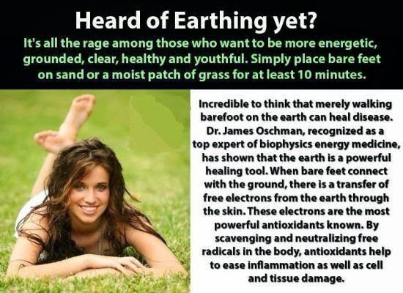
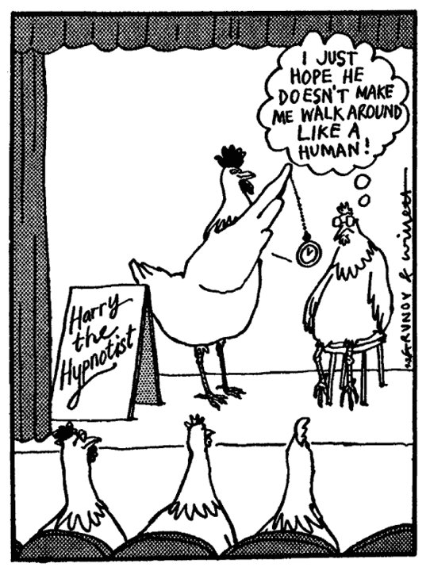
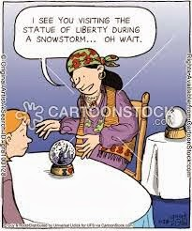
“Pop” Psychology or “Psychobabble”
Unfounded opinions based on popular beliefs.
Urban Legends
Pseudo-science, e.g. “Rebirthing Therapy,” “Phrenology,” “Psychics,” etc.

Slide 6
Why is “Pop” Psychology so popular?
Gives simple answers to complex issues…
Based on “beliefs:” if you have a terrible childhood, you’ll have a terrible life…
Looks for ways to “help yourself.” How to make your relationship work, how to be successful, how to live a longer, healthier life…
Looking for reasons for our failures and validation of our successes and admirable traits…
Confirms our existing beliefs and prejudices…

Slide 7
What do you think???
You are now going to see 12 commonly held beliefs. Your task is to guess whether it is supported by science or not.
If you think that it is, what would be your EVIDENCE?!?

Slide 8
What do you think???
“Cold weather makes you sick.”
We are either left brain or right brain learners.
You lose most of your body heat through your head.
Drinking milk produces more phlegm.

Slide 9
What do you think???
Brain games do NOT make you smarter.
Sugar makes you hyper.
You only use 10% of your brain.
If you’re brain damaged, it can fix itself.
Listening to Mozart makes you smarter.

Slide 10
What do you think???
Your brain works better under pressure.
Eating carbohydrates before a test could hurt your concentration.
Married couples have better sex lives than single people.

Slide 11
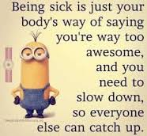
What do you think???
1. “Cold weather makes you sick.”
Nope. In studies of cold transmission, people who are chilled are no more likely to get sick than those who were not. It may be that cold weather keeps people indoors, where germs are more likely to catch up with you…but germs make people sick, not temperature.

Slide 12
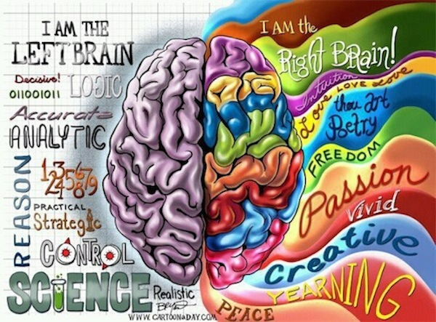
What do you think???
2. “We are either left brain or right brain learners.”
Nope. Brain scan experiments show that the two halves of the brain are much more intricately linked than was originally thought, so problem-solving or creative tasks fire up activity in regions of both hemisphere of the brain.

Slide 13
What do you think???
2. “We are either left brain or right brain learners.”
Nope. Brain scan experiments show that the two halves of the brain are much more intricately linked than was originally thought, so problem-solving or creative tasks fire up activity in regions of both hemisphere of the brain.

Slide 14
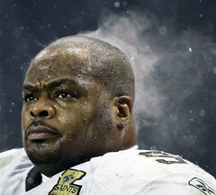
What do you think???
3. “You lose most of your body heat through your head.”
Nope. There’s nothing special about the head and heat loss. You lose heat through any uncovered body part.

Slide 15
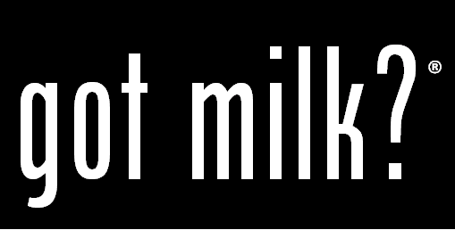
What do you think???
4. “Drinking milk produces more phlegm.”
Nope. In one experiment, volunteers were infected with the cold virus, and some drank a lot of milk as well. The weight of the nasal secretions did not increase in those who drank more milk, nor was it associated with cough or congestion.

Slide 16
What do you think???
5. “Brain games do NOT make you smarter.”
True! More than 8600 people were asked to play online brain games to improve their memory, reasoning and other skills for at least 10 minutes a day, three times a week.

Slide 17
What do you think???
5. “Brain games do NOT make you smarter.”
They were then compared to more than 2700 people who didn’t play any brain games, but spent a similar amount of time surfing the net and answering general knowledge questions. Researching found no distinct difference between the groups.

Slide 18
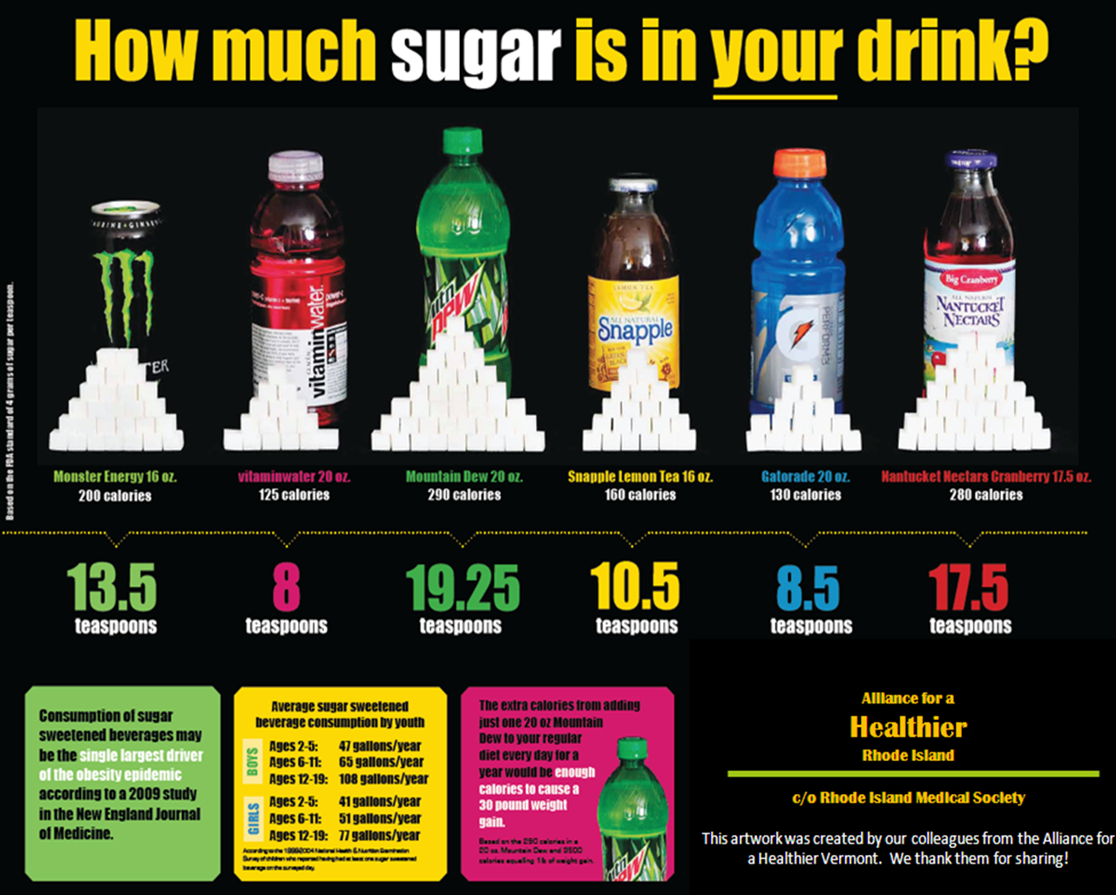
What do you think???
6. “Sugar makes kids hyper.”
Ask your parents…numerous studies show sugar doesn’t affect behavior, but most parents would disagree…In one study, parents were told their kids had sugar and they were more likely to report problem behavior—in reality, the kids had consumed a sugar-free drink.

Slide 19
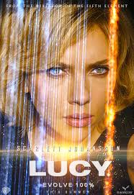
What do you think???
7. “You only use 10% of your brain.”
Brain scans have shown that no matter what we’re doing, our brains are always active. Some areas are more active at only one time than others, but unless we have brain damage, there is no one part of the brain that is absolutely not functioning at any given time…

Slide 20
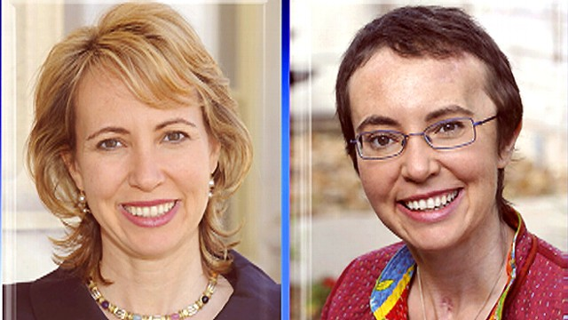
What do you think???
8. “If a brain is damaged, it can in some cases fix itself...”
Patients surprise doctors all the time and exceed expectations of what they’re able to do days, months, and even years later. Not all brain damage is permanent.

Slide 21
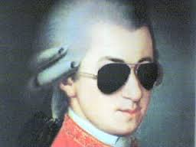
What do you think???
9. “Listening to Mozart makes you smarter.”
Nope. There is currently no scientific information to prove that listening to Mozart, or any other classical music makes people smarter.

Slide 22
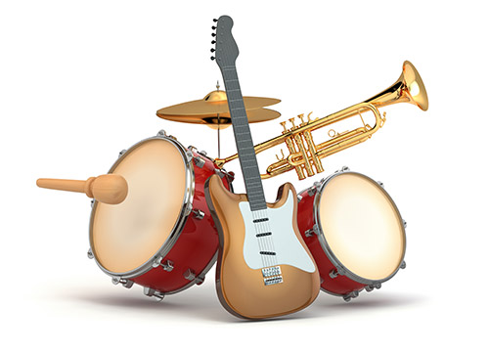
What do you think???
9. “Listening to Mozart makes you smarter.”
One researcher even said the money spent by this study might be better spent on musical programs—there is some evidence to suggest that learning an instrument improves concentration, self-confidence, and coordination.

Slide 23
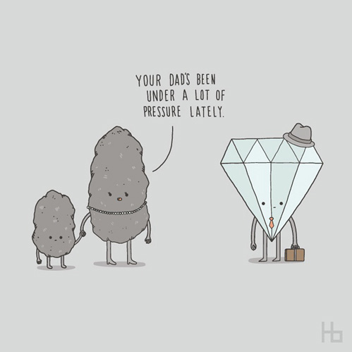
What do you think???
10. “Your brain works better under pressure.”
Not exactly…A chronic over-reaction to stress overloads the brain with powerful hormones that are intended only for short-term duty in emergency situation. Their cumulative effect damages and KILLS brain cells.

Slide 24
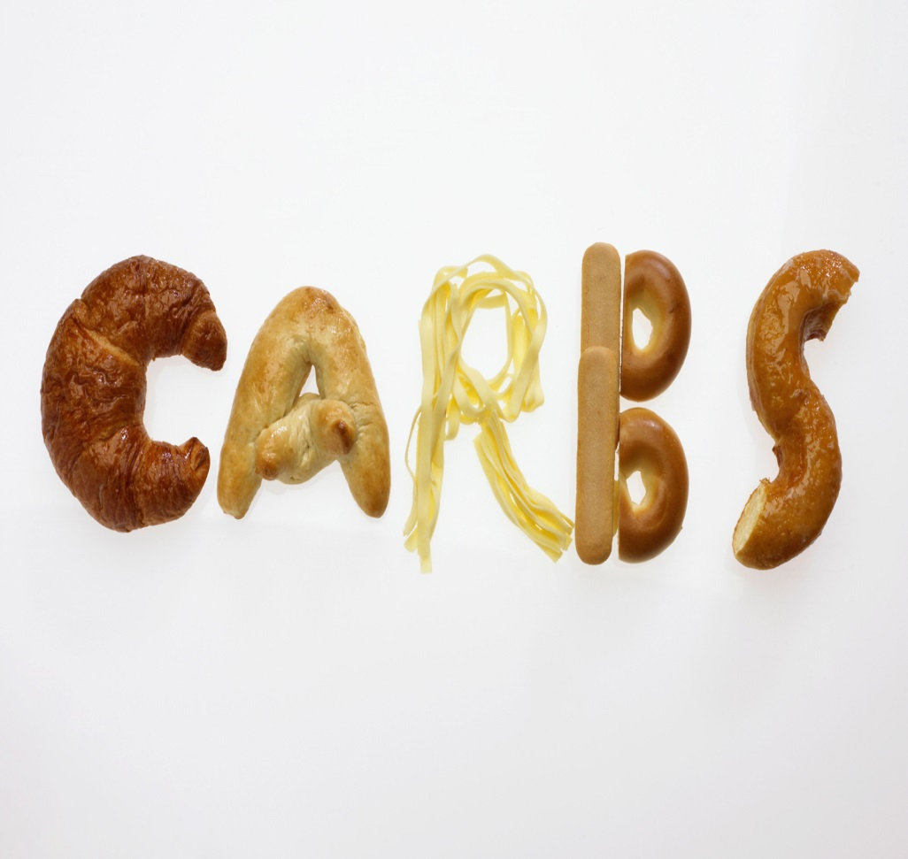
What do you think???
11. “Eating carbohydrates before a test could hurt your concentration..”
Partly true…Carbs that are high in starch (potato/pasta) or sugar can give you a boost of energy which will soon fade and leave you less concentrated towards the end of your exam. However, not all carbs are bad for you. Good carbs include whole grains…

Slide 25
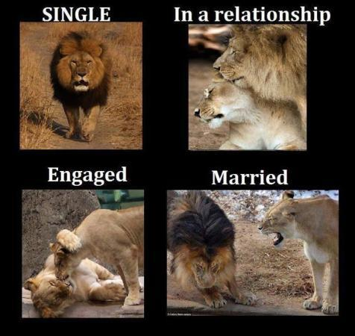
What do you think???
12. “Married couples have better sex lives than single people.”
Married people typically engage more often in any given year than single people. 43% of married men reported more than once per week, while only 26% of single men reported the same frequency.

Slide 26
So, what’s the point???

