Slide 1
IB Psych 9/13/16
Turn in:
Nothing
Take out :
Planner
Middlemist Response
Notes/Paper
Note-taking devices
Today’s Learning Objectives:
I can utilize all of the command terms of Level 1: Knowledge and Comprehension.
Today’s Agenda:
Middlemist Response
Exercise #2
Experiments
HW:
Evaluate Experiments (In class…)

Slide 2
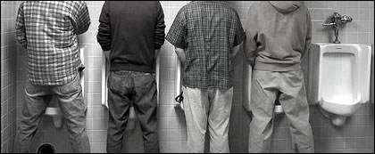
Middlemist et al. 1976
Some would question the ethics of this study…
What’s at issue? Is it a big deal? What are we really hoping to learn from this work?

Slide 3
Gerald Koocher (1977) - Bathroom Behavior and Human Dignity
Investigators should have made the cost/benefit rationale explicit.
What cost/benefit ratio?
Cost to the human dignity to participants: Benefits to the participant and to society/science.
“I subscribe to the belief that when a potential problem of a subject’s [sic] rights is at issue, a discussion of the cost/benefit rational is imperative” (p. 121)

Slide 4
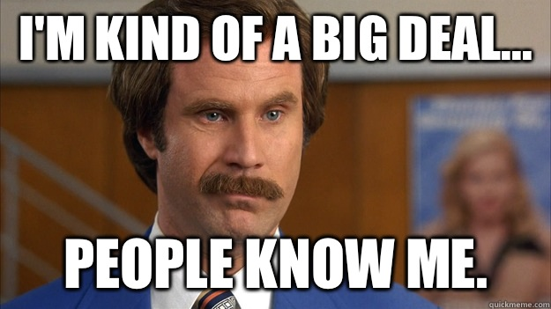
A Reply to Koocher – Middlemist et al. (1977)
What’s the big deal???
The behavior was naturally occurring and would have happened without the presence of the observer
Pilot Study: All men indicated a low level of concern and were not bothered by the study.
All have encountered similar invasions of personal space at other times
However, participants in the main study were not debriefed.
Authors believed that their study had benefits and little costs.

Slide 5
Is Deception Needed???
Debriefing
Occurs after completion of the study
Opportunity for the researcher to deal with issues of withholding information, deception, and potential harmful effects of participation
Explains why deception was necessary
Provides additional resources, if necessary
Makes sure participant leaves the experiment without any ill feelings towards the field of psychology

Slide 6
Positive aspects of debriefing:
Provides an opportunity to explain the purpose of the study and anticipated results
Most participants report positive experience
Research suggests that it is effective

Slide 7
Personal Space
https://www.youtube.com/watch?v=nm-VzJZXDBc
https://www.youtube.com/watch?v=mvUPLN_eaVw

Slide 8
Suitable sampling???
School site (vertical seating?!?)
Caffeine/Alzheimer’s
Drugs and student performance
Popular sportsperson

Slide 9
Experiments? Table Groups…
Obedience Training #1
Obedience Training #2
The “Monster Study”
“Little Albert”
Evaluate the studies with the “checklist” from yesterday…be prepared to present your findings to the rest of us.

