Slide 1
IB Psych 9/27/16
Turn in:
Nothing
Take out :
Planner
Writing Implement
Your Notes from your Reading…
Textbook
Word Processing Tool
Today’s Learning Objectives:
I can OUTLINE principles that define the Biological Level of Analysis
Today’s Agenda:
Writing a response to SAQ…
HW:
SAQ Practice (By Wednesday)

Slide 2
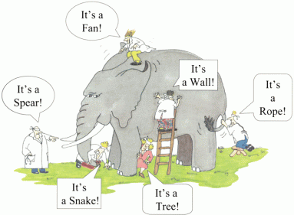
Oh, Writing, you’re so Subjective…
There are numerous ways to write effectively…and there’s the rub.
While it is not required to have an introduction, body paragraph, and conclusion…it is highly recommended to have discernable parts of your response.
Quality over Quantity…give depth, but be focused.

Slide 3
Oh, Writing, you’re so Subjective…
Be sure you understand the purpose of the command term posed in the question.
For your current task, “OUTLINE”
What the IB Guide states: “Give a brief account or summary of something.”
What it means: “Give a brief summary of whatever is mentioned in the question.”
For your current task, “EXPLAIN”
What the IB Guide states: “Give a detailed account including reasons and causes.”
What it means: “Give reasons and causes for a behavior or psychological phenomenon.”

Slide 4
Some other suggestions…
Define the keywords in the IB Psychology SAQ and integrate the definitions into a “In other words…” sentence.
Make sure you use the words from the question in your answer at least two or three times. If the IB Psychology SAQ is about physiology use this word rather than brain or body.

Slide 5
Some other suggestions…
Use studies to support your explanations. Give a brief summary of the study and then explain why this is relevant.
Take every opportunity to evaluate the study but do not just outline every strength and limitation, only the relevant ones. For example there is no need to discuss ethical considerations with the Davidson meditation study from the BLOA but the small sample size is relevant as it makes generalizing his finding that cognition can change brain physiology more limited.

Slide 6
Some other suggestions…
Aim for a short introduction and conclusion. These can be one to two sentences in length. If you are asked about two hormones or two studies or two neurotransmitters make sure you have two body paragraphs.

Slide 7
Some other suggestions…
Use each other’s experience and expertise to deepen your understanding of your topics and tasks…if you find a technique that’s helpful—share it! (the techniques, that is…)

