Slide 1
10th Euro Studies 9.29.16
Turn in:
CSI: Skyline online (Yesterday…)
Take out:
Planner
Notes & note-taking devices
Today’s Learning Objectives:
I can describe how a mysterious illness began to spread across Europe in the late Middle Ages, and the impact it had on society.
Today’s Agenda:
More on the Church
The 100 Years War
Transitions
HW:
CRA “A Medieval Holocaust:” (Online…)
CRA 13.1—up to the 2nd checkpoint question: answer the two ?’s online (there will be a button)

Slide 2
Good ol’ Feudalism…
Feudalism begins to fall apart (parts of it will exist for a long time, though)
We’ve discussed the Plague…now another major cause of its collapse…

Slide 3
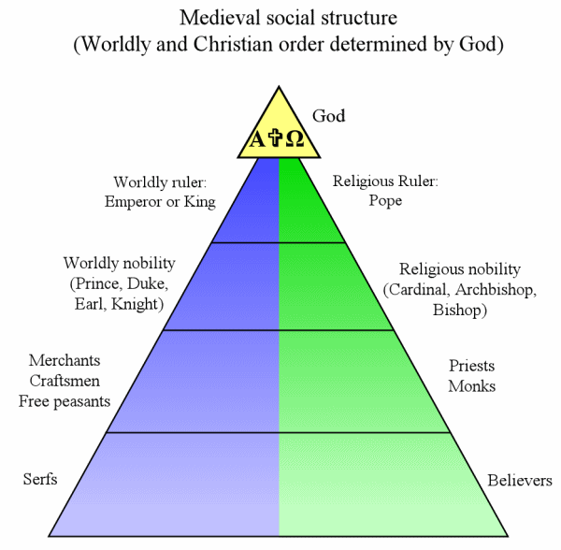
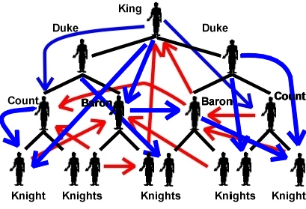
Feudalism begins to fall apart (parts of it will exist for a long time, though) We’ve discussed the Plague…now other major causes of its collapse…
What feudalism really looked like

Slide 4
Hundred Years War 1337-1453 France vs England
Begins as a dispute over succession rights to the French throne
Two main phases: England wins, then England loses
Ends with French kicking English out of continent
Importance:
Key changes in warfare, like the longbow, means the eventual end of knights
Strengthens French monarchy and weakens English nobles—king becomes more important
The concept of what we would now call “Nationalism” in England and France begins—associated with the monarch (king)

Slide 6
The Catholic Church of this time is Corrupt…
very, very, VERY CORRUPT
As the one thing that ties Europe together, Catholic Church is everywhere
Controlled birth, death, marriage, salvation, education, etc.—Sacraments, yes???
Functioned like a massive multi-national corporation with its own state and army and the pope as its chief executive officer—treating Church happenings as a business…
Church officials from the pope on down break their vows – celibacy, poverty, and abuse power
Wait a minute…what?!?

Slide 7
1200-1400 AD: Catholic Church Corruption
Many village priests married and had children-this was against Church rules
Bishops sold positions in the Church for money—a practice called simony
Church started to sell indulgences—get out Purgatory cards. Church getting rich off the poor!
Various groups revolt against the corruption of the church.

Slide 8
So, all of this corruption is really upsetting the order of the Medieval world…HIERARCHY makes sense as long as things run smoothly.
But, what happens when things begin to break down?
Retribution—the end of the world=Black Plague (Black Death)

Slide 9
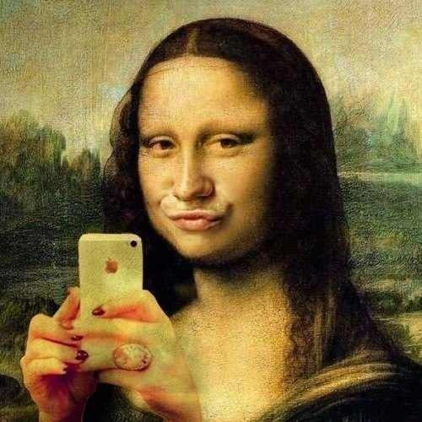
As Europe began to reform and rebuild itself it created a new society that would form the essence of the Modern Western World.
PLEASE GET OUT YOUR 3 COLUMN CHART FROM EARLIER THIS YEAR!!!

Slide 10
Renaissance 1300-1600
Word literally means “rebirth” (in French)
What was reborn was a Classical (Greek & Roman) ideas—art, architecture, philosophy, literature, finance, views of the world, etc. These had been suppressed by the Church (WHY??)
Began in Italy—mainly Florence—in 14th century, and moved to the rest of Italy—like Venice—in 15th century, as it spread through Southern Europe
Then spread to Northern Europe, through Holland and Flanders and onto England and Denmark and Sweden.
Mainly affected wealthy/educated people

Slide 11
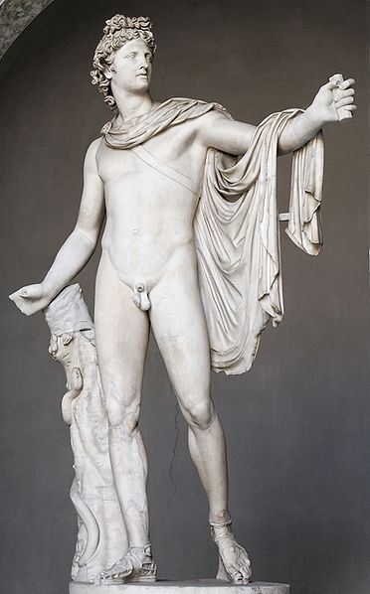
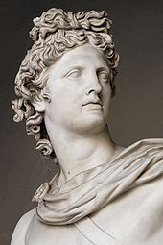
What Was the Renaissance??
Period after Middle Ages (~1350-1550)
“Rebirth” of knowledge and culture
Emphasis on Ancient Greece and Rome (Classical)
Shown through art, architecture, literature
Beginning of the “modern world”
Apollo Belvedere –
Greek sculpture, 325 B.C.

Slide 12
Why Italy? Location. Location. Location
First European nation affected by the plague = first country to return to health and city life
Church structure particularly weakened by plague = more secular approach, more concern for the arts
Commercial Revolution. Wealthy due to trade from the Crusades = more exchange of people and ideas particularly from Islamic and Byzantine lands
Loose confederation of states = much easier to change one or two parts, like Venice or Florence than a whole country, like England
Had most of the classics buried in their land = easier to find through excavation and searching in the depths of churches

Slide 13
Why Renaissance? Why Florence?
Vocab Words (Vernacular): Please know and understand the following terms:
Classical: Ancient Greece and Rome including the culture.
Civic Humanism: Active, ethical, and patriotic service to the city-state
Humanities:
Patron:
Petrarch:
Florence:

Slide 14
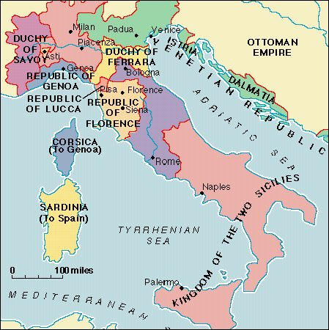
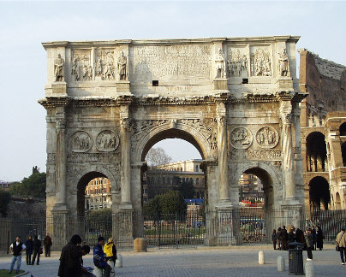
When and Where?
1350-1550 in Italy – “Geography is Destiny”
Lots of big city-states
Competition
Lots of $$$$
Bankers and Merchants
Vatican = Home of Catholic Church
Papal States
Classical Times = Roman Ruins
Constantine’s Arch, 315 AD (Rome)

Slide 15
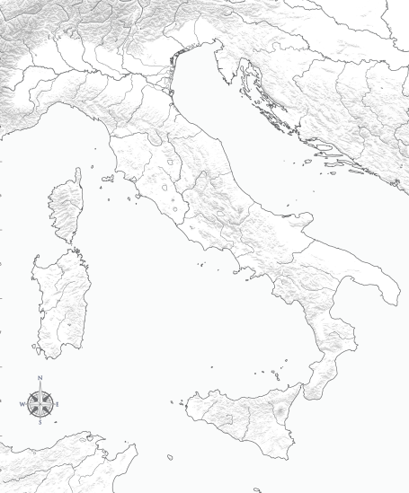
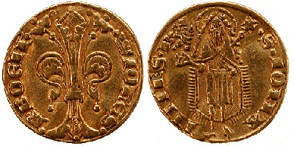
Italian City-States Control Trade
Milan – Controlled trade through the Alps
*Metal Goods/Armor
*Sforza Family
Venice – Controlled Adriatic Sea trade
*Crusades
*Silk, Spices
Genoa – Access to N. European trade routes
*Ivory/Gold
Florence – Banking Center
*Textiles and Banking
*Medici Family
Milan
Venice
Genoa
Florence
Adriatic Sea
Tyrrhenian Sea
Notes:
City-State: An independent state consisting of a city and the surrounding area
Patron: A person who supports the arts by supplying money for them

Slide 16
What is this Renaissance?
CRA 13.1 up to 2nd Checkpoint Question: “Why was Italy a favorable setting for the Renaissance?”
Please answer both checkpoint questions online (there will be a button…)
Notes:
City-State: An independent state consisting of a city and the surrounding area
Patron: A person who supports the arts by supplying money for them

